Slide 1
CMG vs. Matlab

Slide 2
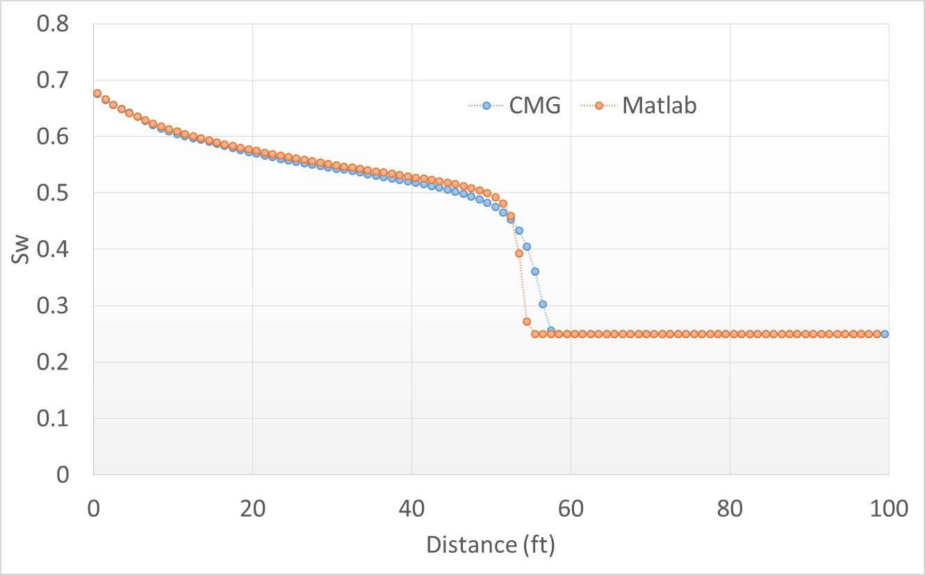
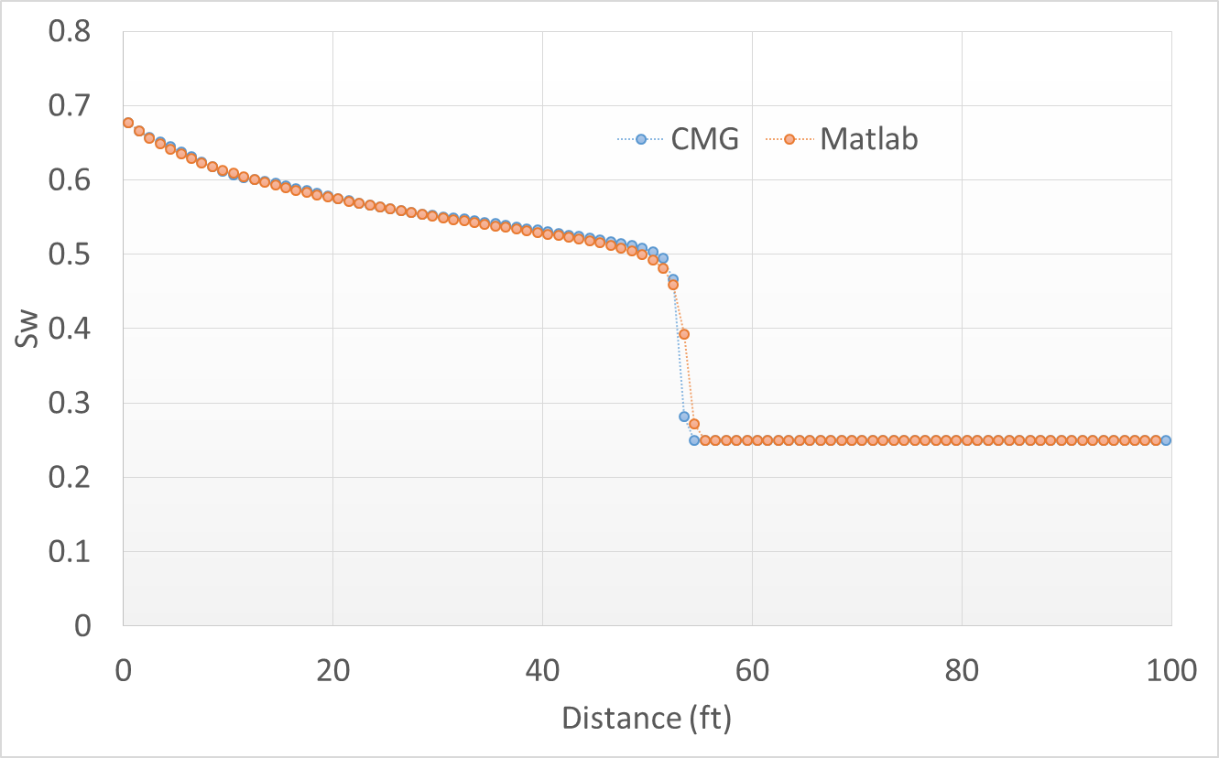
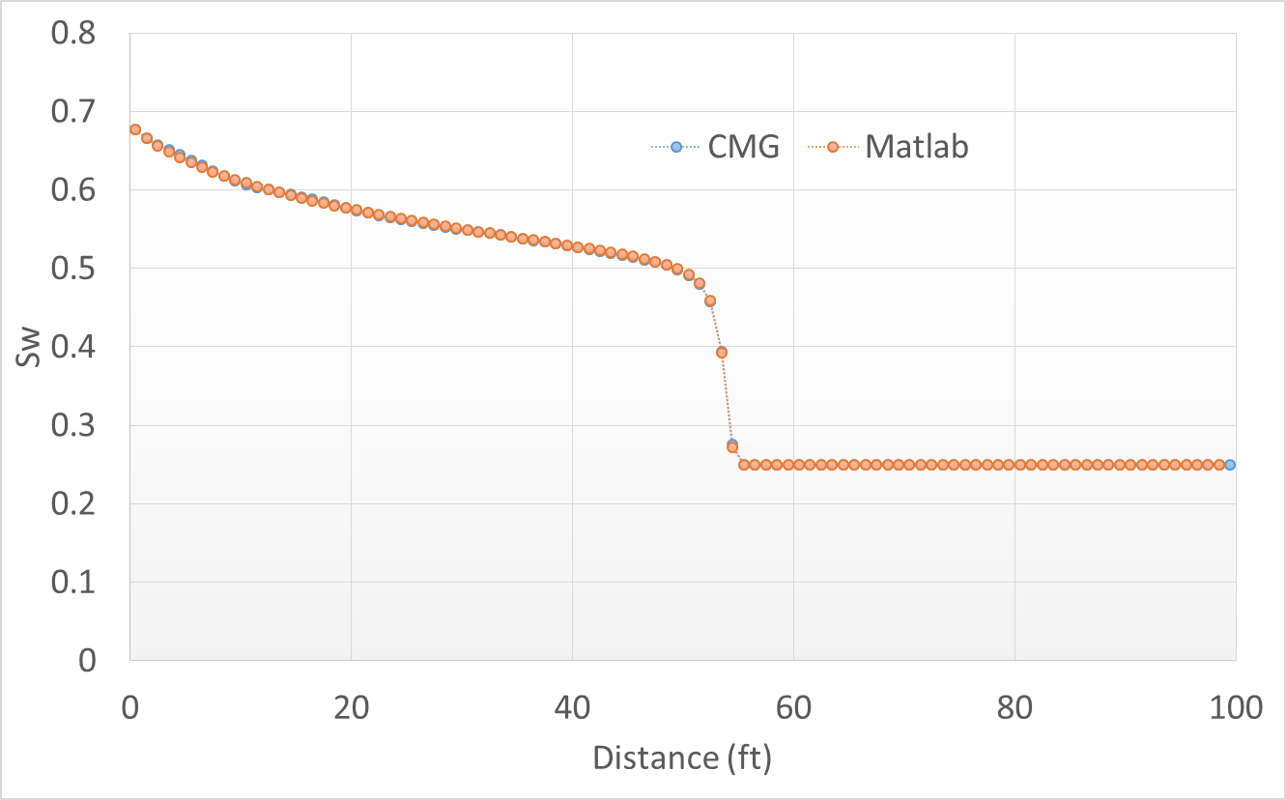
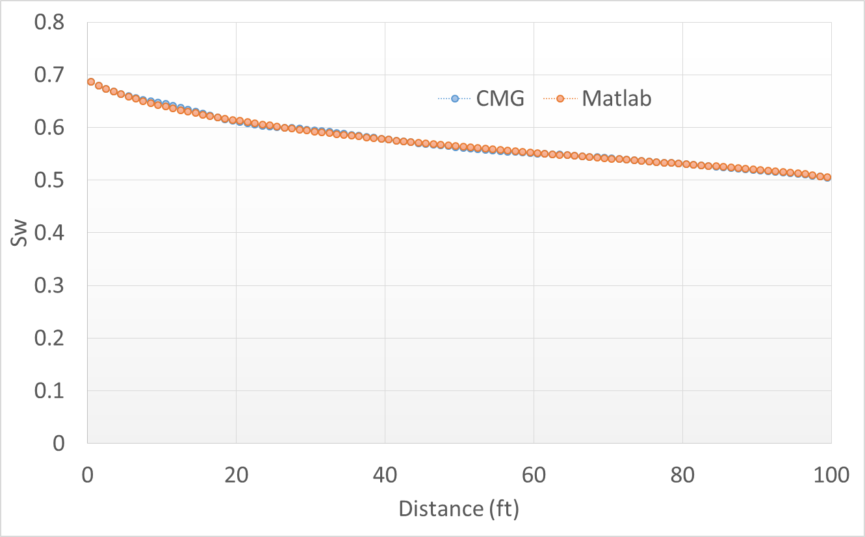
Match 1 : CMG-Implicit
Match 2: CMG-Explicit
Time = 4 days
PVI = 16.845 %
Time = 4 days
PVI = 16.845 %
Match 3: CMG-Explicit with same time step
Match 3: CMG-Explicit with same time step
Time = 4 days
PVI = 16.845 %
Time = 8 days
PVI= 33.69 %

Slide 3
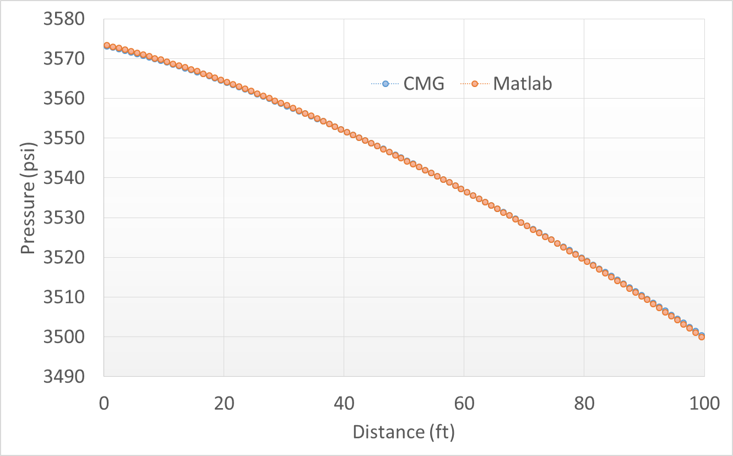
Time = 8 days
PVI= 33.69 %

Slide 4
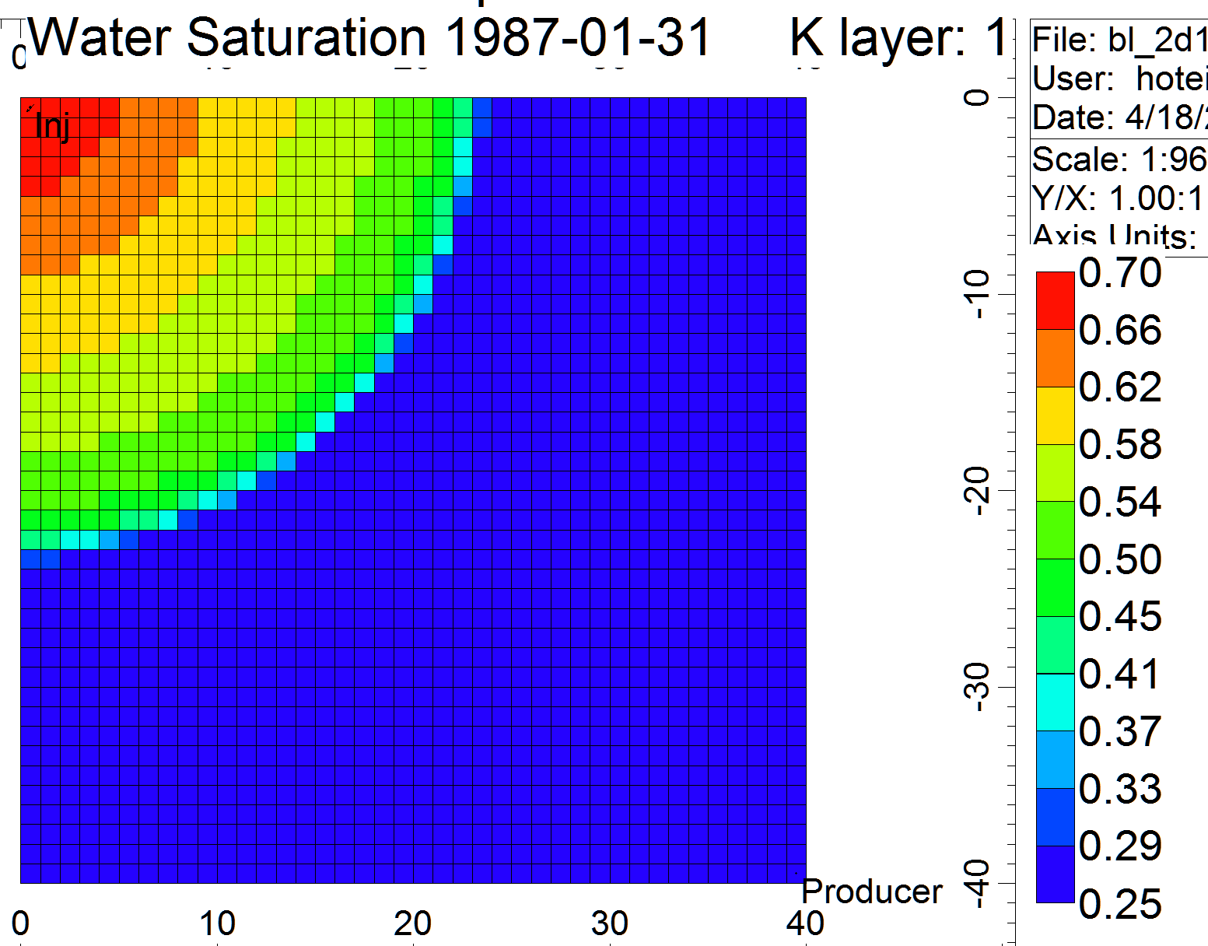
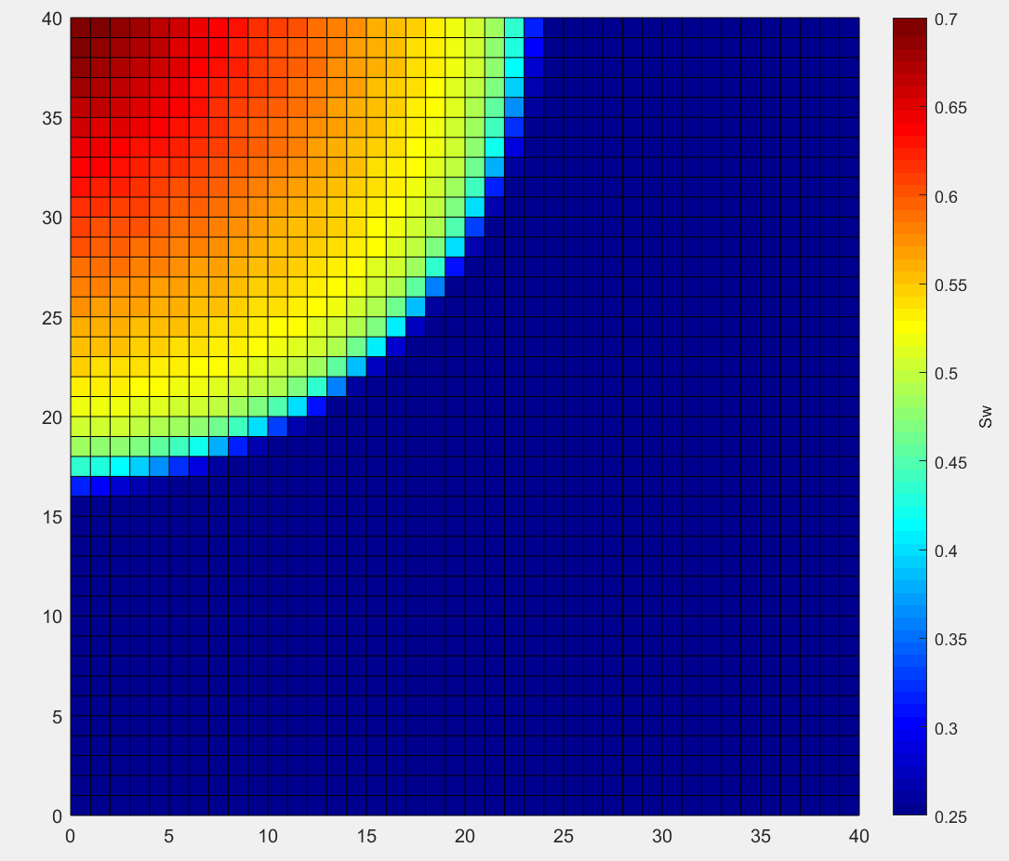

Slide 5
